Slide 1
Overview
Welcome and introductions
Coping and Food Preferences
How big is a portion?
Enjoyable family mealtimes
A taste adventure
Review and next steps

Slide 2
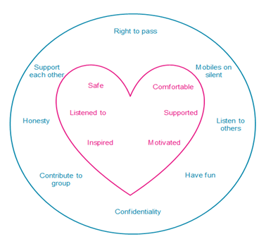
Group guidelines

Slide 3
Food groups

Slide 4
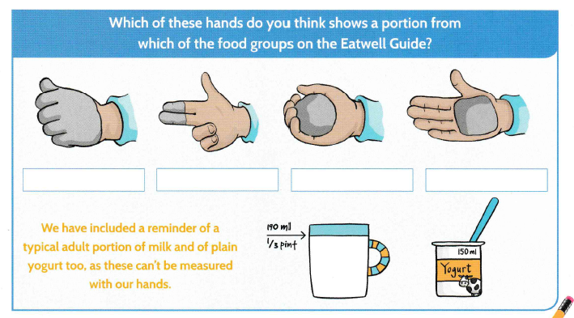
Me Size Meals

Slide 5
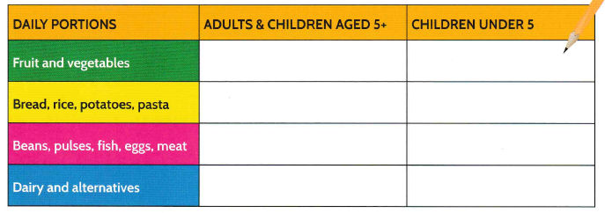
Me Size Meals

