Slide 1
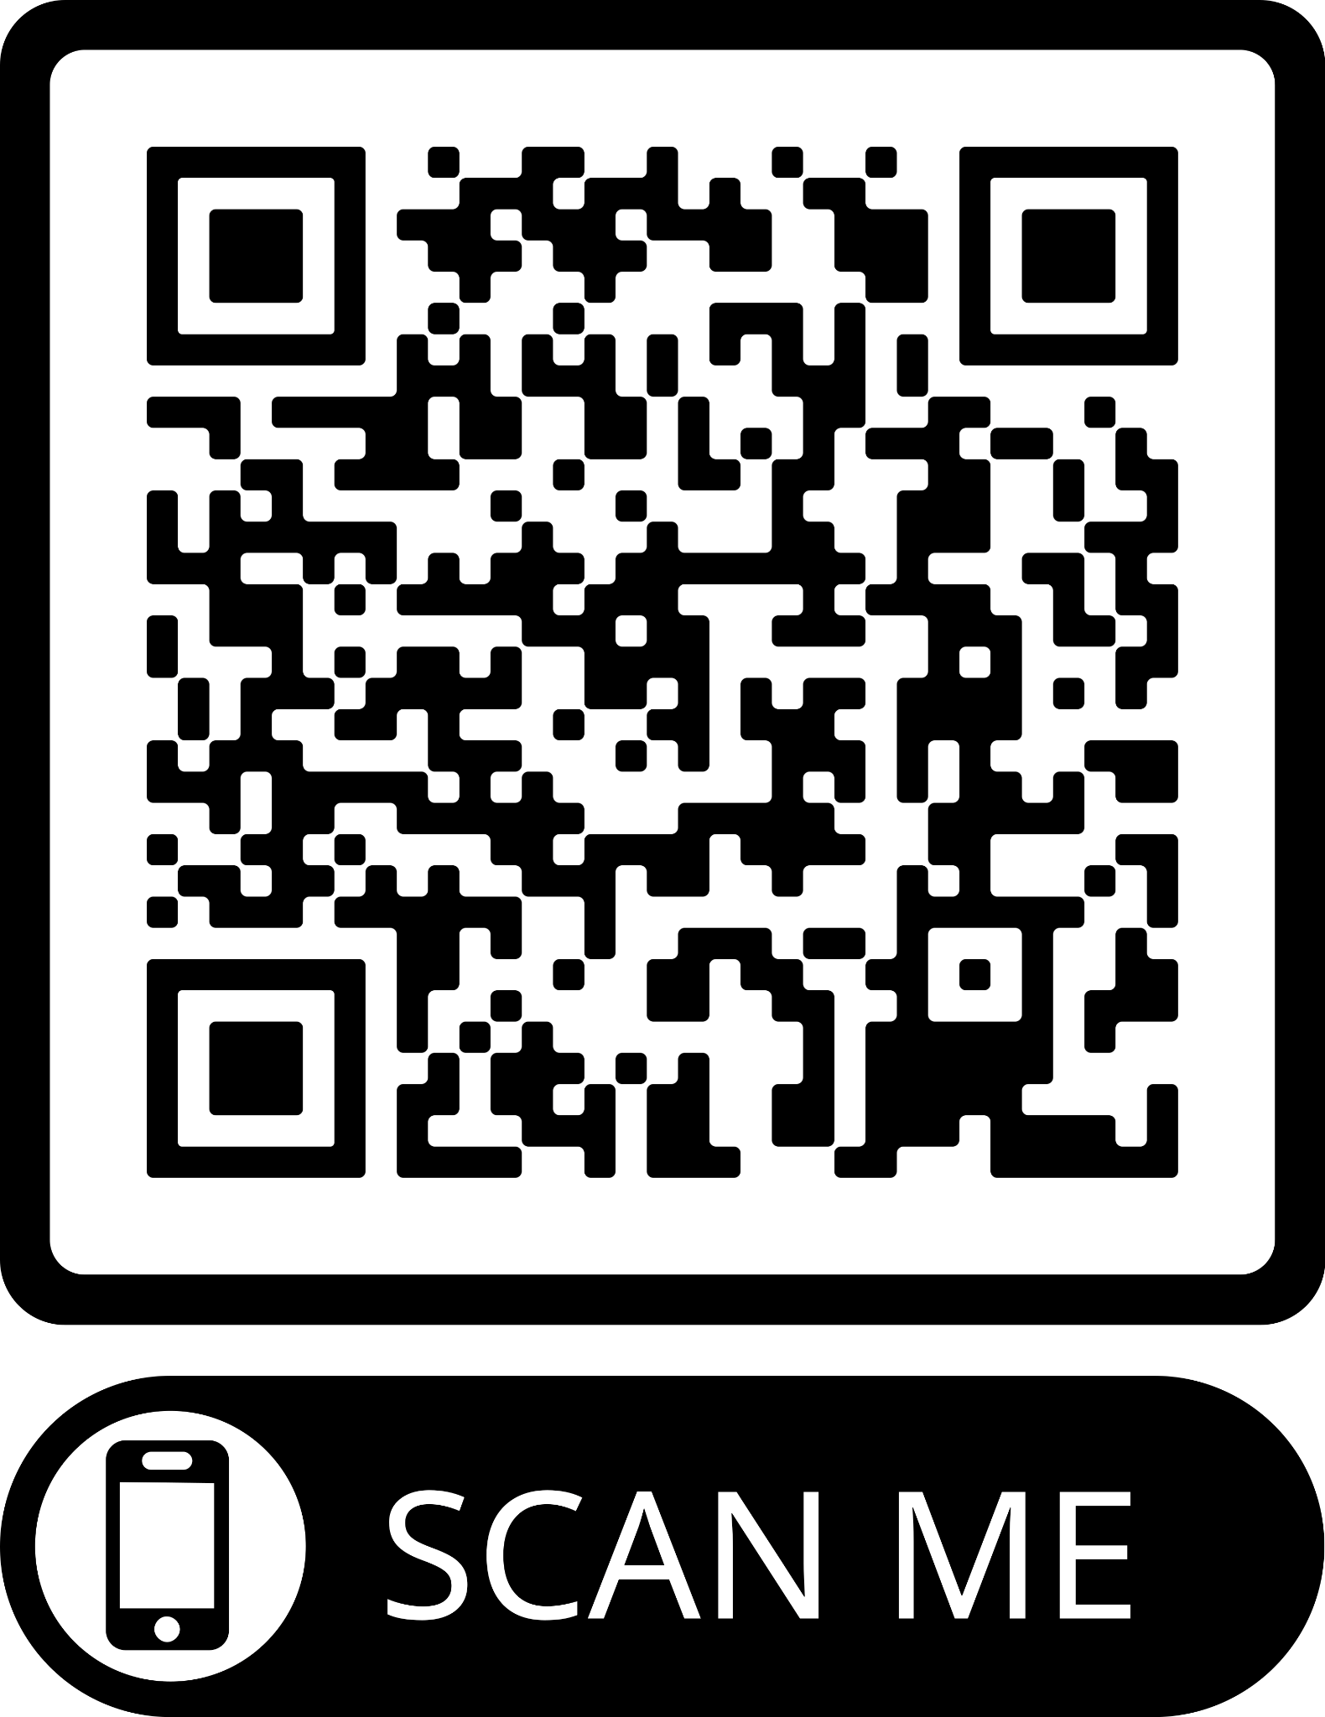
Training ID:
Group Facilitation Training Feedback
Area Code:
Website address: http://links.henry.org.uk/Group-Facilitation-Feedback

