Slide 1
Our Group Guidelines

Slide 2
Boosting our Batteries

Slide 3
Five Ways to Wellbeing
Connect | Be active | Take notice | Keep learning | Give

Slide 4
Watch, Wait, Respond
Watch
Watch, listen to see what your child is interested in Get down to their level
Wait Pause to see what your child asks/shows you Notice how they communicate-look, point, sound
Respond
Copy what they are doing Make a sound/word to match what they’re interested in, crunchy, cold. Point or gesture to help them tune into the word

Slide 5
Styles of Parenting
Being in Charge
Being Responsive

Slide 6
Eating Habits
Healthy eating habits
Less healthy eating habits

Slide 7
Giving Children Choices
No choice | Guided choice | Too much choice
We’re off to the park. Let’s get your coat on | We’re off to the park. Coat or boots first? | Would you like to go to the park?

Slide 8
Active Play
Babies | Toddlers | Pre- school children

Slide 9
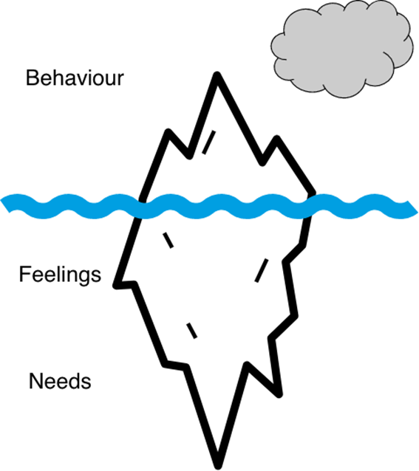
Feelings, Behaviour and Needs
Add text here
Add text here
Add text here

Slide 10
Quick Quiz
How often should we visit the dentist?
When should I stop brushing my child’s teeth for them?
How long should I or my child brush their teeth for?
What toothpaste should be used for children’s teeth?
What’s the best way to make sure the fluoride stays on the teeth after brushing?
How much will an NHS dentist charge to see my child?
What everyday objects will help with tooth brushing?

Slide 11
Solution Spotting
What’s going well | Challenges
How we do it | How to solve them

