Slide 1
Understanding children’s behaviour
Behaviour, feelings and needs
Let’s listen
Empathy

Slide 2
OUR GROUP GUIDELINES Feelings are at the heart of all behaviour
Right to pass
Listen to others
Share ideas
Safe Valued
Not judging
Inspired
Ask questions
Comfortable Motivated
Confident
Keep confidentiality
Respect other’s opinions
Mobiles on silent

Slide 3
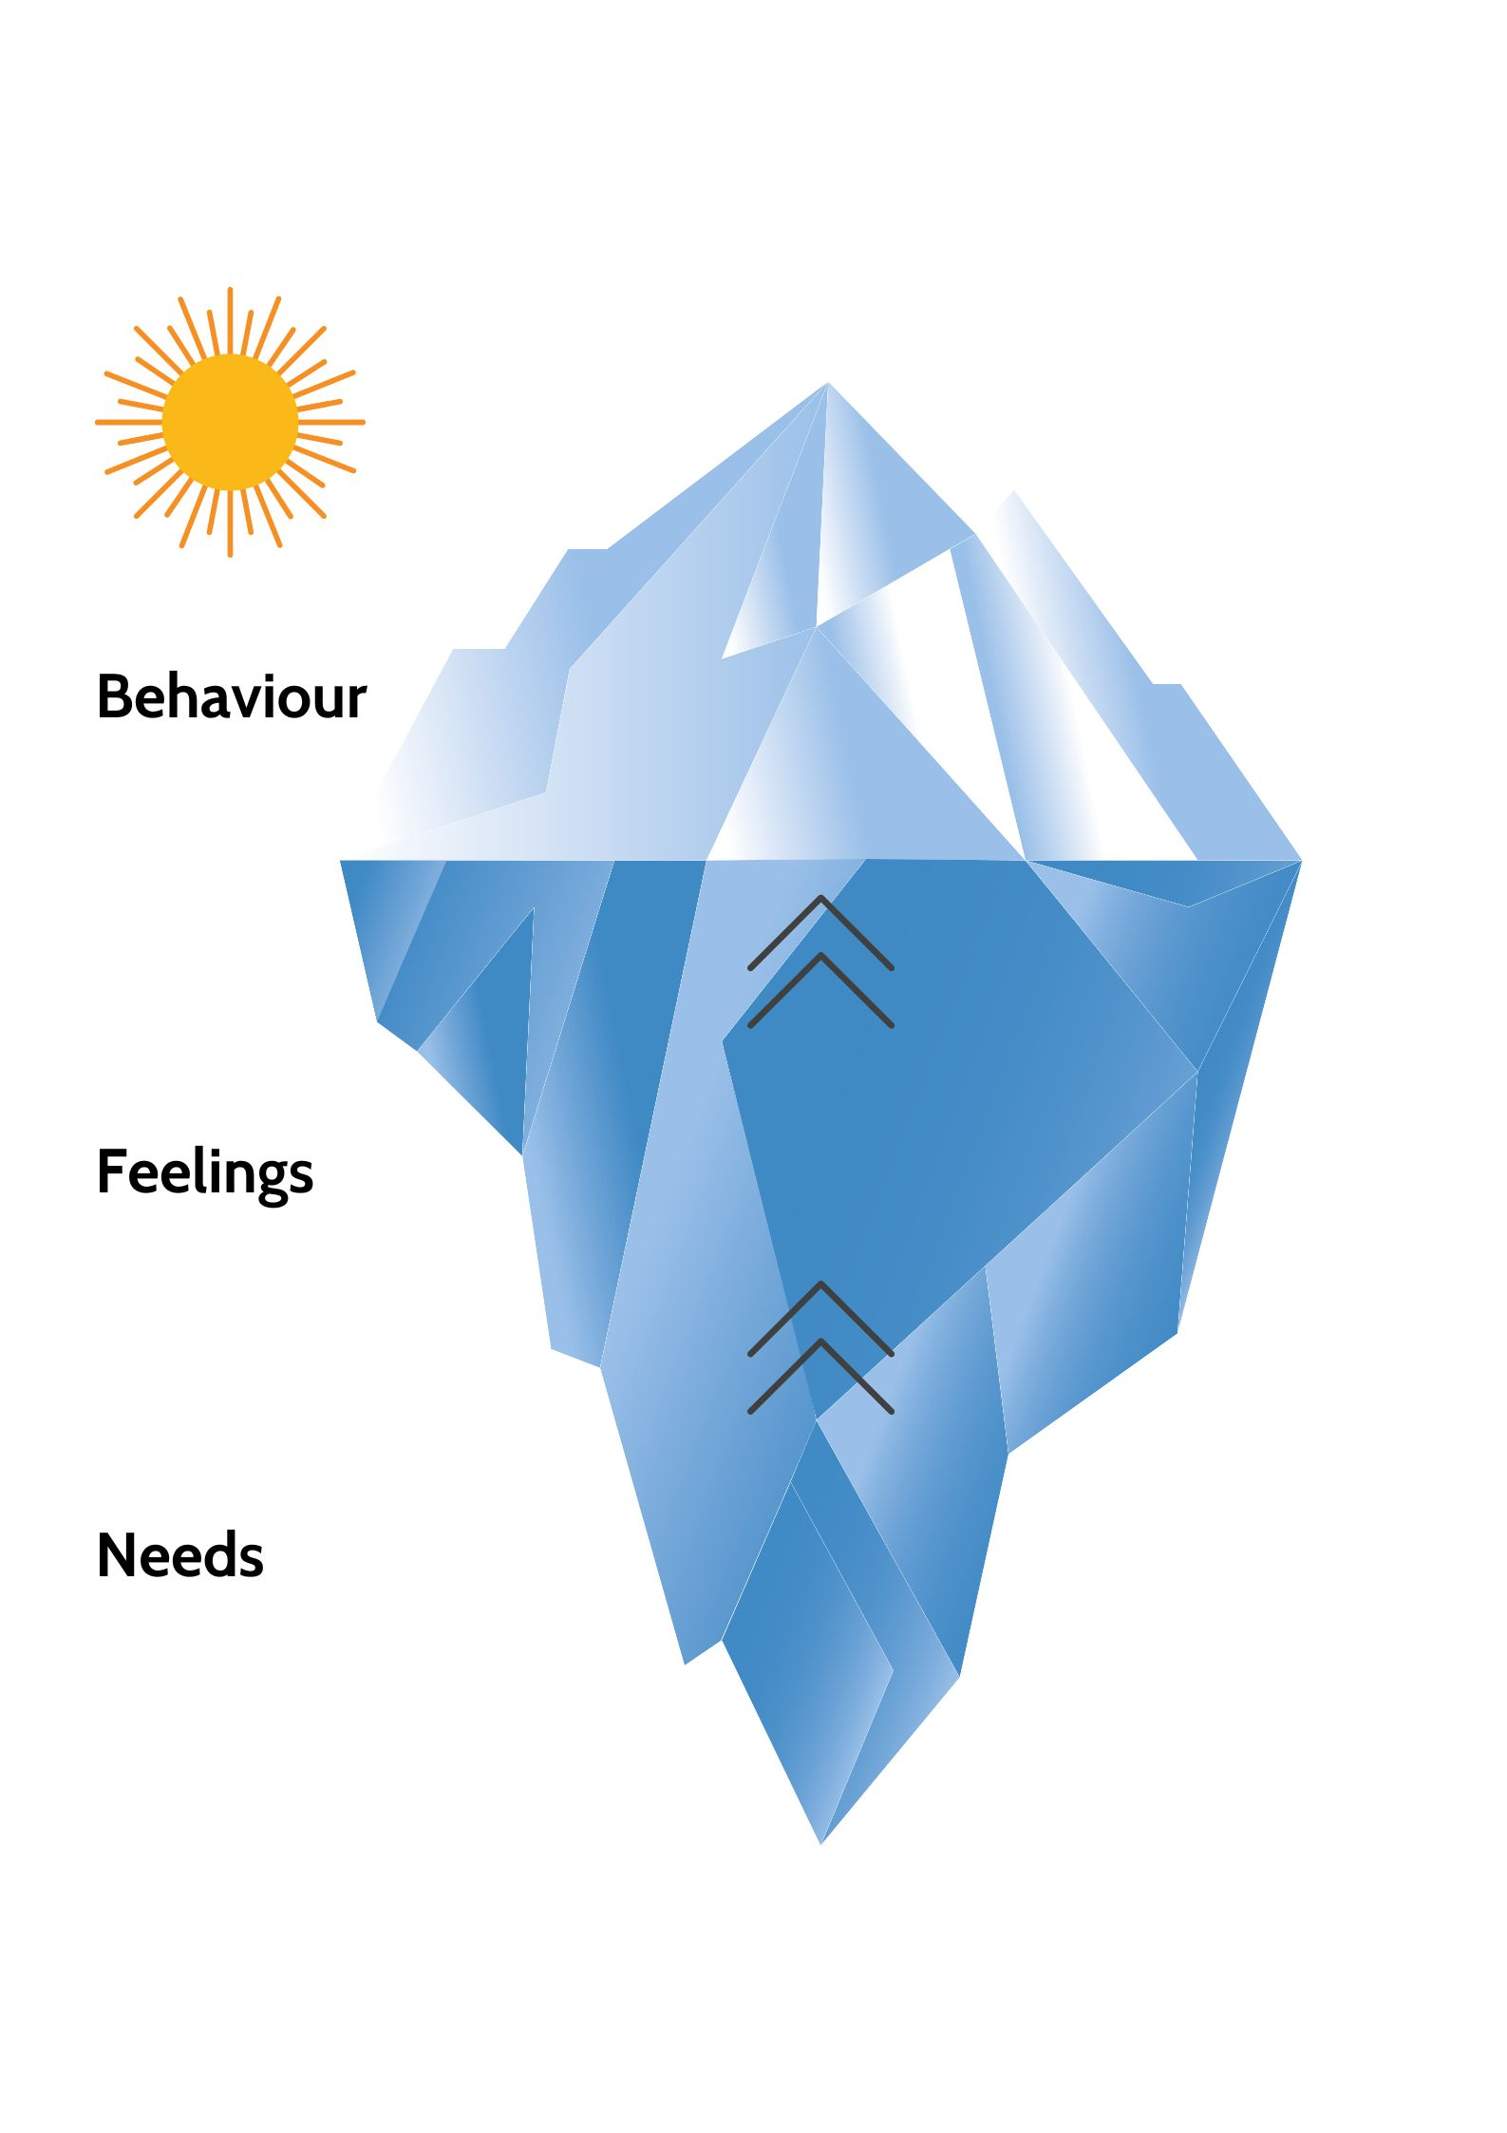

Slide 4
Smiling
Playing
Sharing
Squealing
Happy
Excited
Attention
Fun

